Slide 1
Normal linear model
蒋智超
2025年 秋
Notes:
最小二乘估计不需要任何假设
但是要研究最小二乘的估计量有什么性质，需要一定的模型假设。
问题一：最小二乘估计的均值方差是什么，为什么要用最小二乘估计而不是其他的估计 optimality of OLS
问题二：最小二乘估计有什么统计性质，如何做统计推断，即从有限样本得到的beta hat 去估计总体中的beta，有什么样的不确定性
第一个问题 用gauss markov model
第二个用Normal linear model

Slide 2
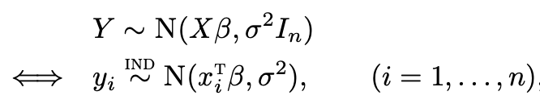
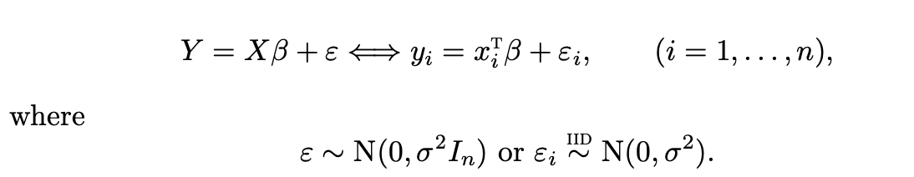
Normal linear model
Gauss-Markov model
Calculate mean and variance of OLS estimator, obtain unbiased variance estimator
Show that OLS estimator is BLUE
Inadequate for statistical inference without distribution of the estimator
Normal linear model
or equivalently
Notes:
Question: relationship between Gauss-Markov and Normal linear models

Slide 3

多选题
1分
Under the Normal linear model, which of the following statements are correct?
A
The OLS estimator is unbiased
B
The OLS estimator is the MLE
C
The OLS estimator is the MVUE
D
The OLS is the BLUE
提交

Slide 4
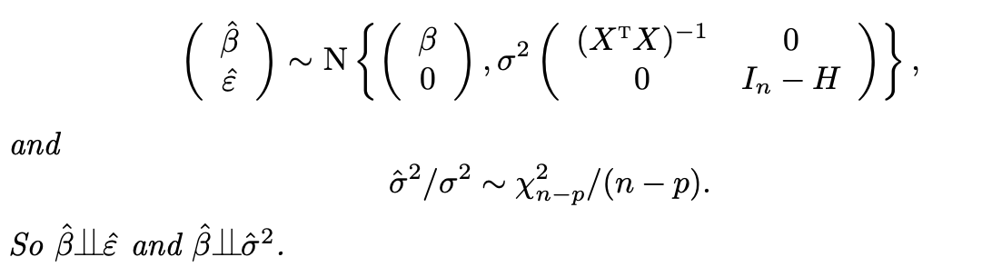
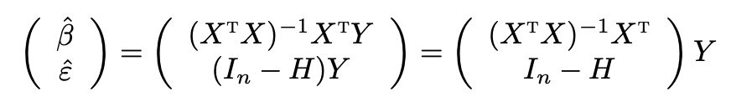

Joint distribution of $（\hat{β},{\hat{σ}}^{2}）$
Proof:
Notes:
Under the normal linear model, ols is the MLE

Slide 5

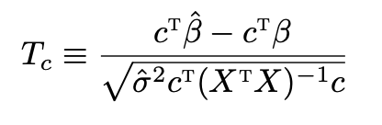

Inference: scalar parameter
Inference for $c^{T}\hat{β}$ where $c$ is a $p$-dimensional vector
But this is not useful because $σ^{2}$ is unknown
Replace $σ^{2}$ with its unbiased estimator ${\hat{σ}}^{2}$
Notes:
Question: CI 定义
Confidence interval meaning 95% 置信水平

Slide 6
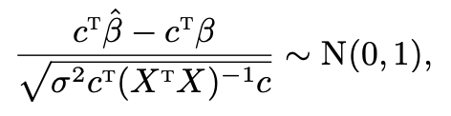

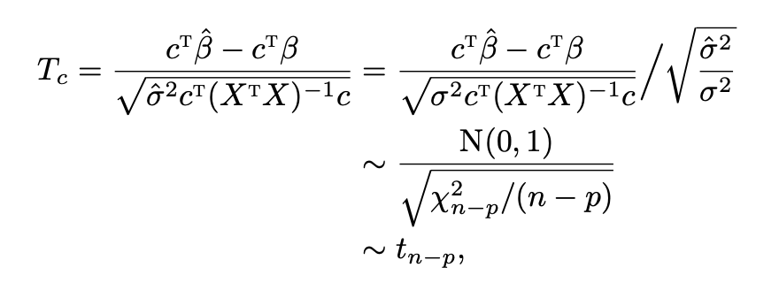
Inference: scalar parameter
Pivotal quantity
Depends on the observed data and the unknown true parameter
Its distribution does not depend on the data and the parameter
Key to hypothesis testing and confidence interval construction

Slide 7
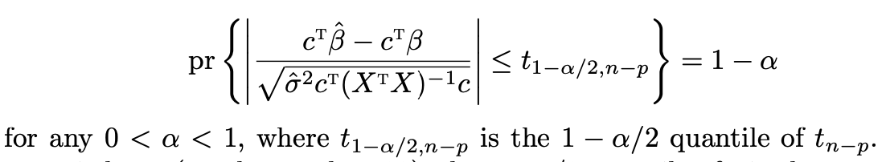
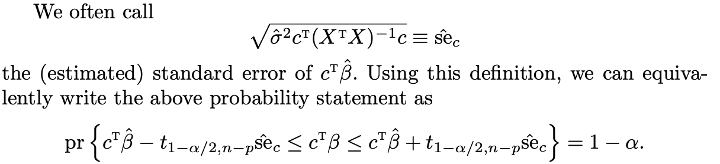
Confidence interval for scale parameter
Hypothesis testing confidence interval
Notes:
Question: how to calculate p values
Questions：
The p-value is not the probability that the null hypothesis is true, or the probability that the alternative hypothesis is false
The 0.05 significance level (alpha level) is often used as the boundary between a statistically significant and a statistically non-significant p-value. However, this does not imply that there is generally a scientific reason to consider results on opposite sides of any threshold as qualitatively different.
The p-value does not indicate the size or importance of the observed effect.

Slide 8


Revisit the Student’s $t$ Theorem
$X_{1},…,X_{n}$ are i.i.d. $N(μ,σ^{2})$
Sample variance $S^{2}=\frac{1}{n−1}∑{\left(X_{i}−\overline{X}\right)}^{2}$
$\frac{\sqrt{n}\left(\overline{X}−μ\right)}{S}∼t_{n−1}$
A regression perspective
Normal linear model: $X_{i}=μ+ε_{i}$, $ε_{i}∼N(0,σ^{2})$
OLS estimate: $\hat{μ}=\overline{X}, {\hat{σ}}^{2}=S^{2}$
Inference on $μ$: $\frac{\sqrt{n}\left(\overline{X}−μ\right)}{S}∼t_{n−1}$

Slide 9

Revisit the two sample comparison
$X_{1},…,X_{n}$ are i.i.d. with mean $μ_{1}$ and variance $σ^{2}$, $Y_{1},…,Y_{m}$ are i.i.d. with mean $μ_{2}$ and variance $σ^{2}$
pooled variance $S_{pool}^{2}=\frac{1}{n+m−2}\{∑{\left(X_{i}−\overline{X}\right)}^{2}+∑{\left(Y_{j}−\overline{Y}\right)}^{2}$}
$\frac{\sqrt{nm/(n+m)}\left(\overline{X}−\overline{Y}−μ_{1}+μ_{2}\right)}{S_{pool}}∼t_{n+m−2}$
A regression perspective
Normal linear model: $X_{i}=μ_{1}+ε_{i}, Y_{j}=μ_{2}+ε_{j},$ $ε_{i}∼N(0,σ^{2})$
OLS estimate: ${\hat{μ}}_{1}=\overline{X},{\hat{μ}}_{2}=\overline{Y}, {\hat{σ}}^{2}=$ $S_{pool}^{2}$
Inference on $μ_{1}−μ_{2}$

Slide 10
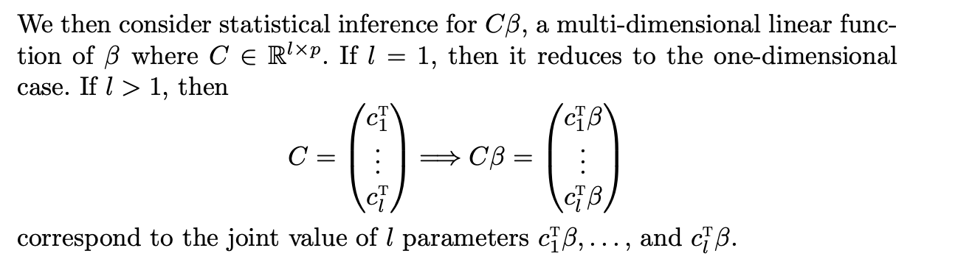
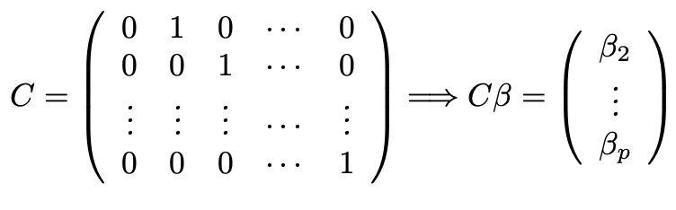
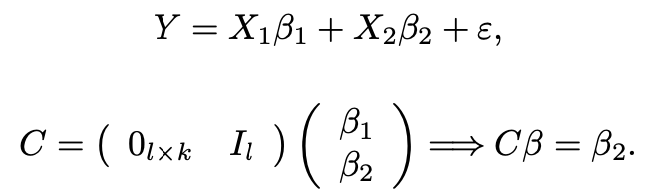
Inference: vector parameters
Examples:
Notes:
Question: can l be larger than p?
Most software packages report the test of the joint significance of beta_2 to beta_p

Slide 11
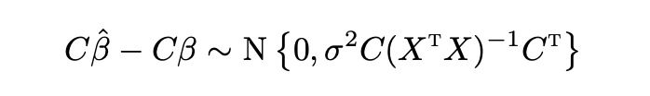

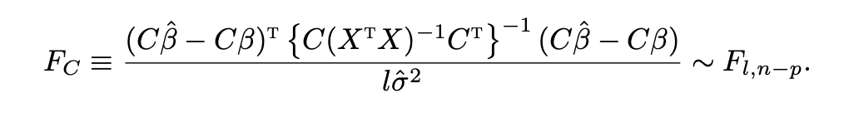
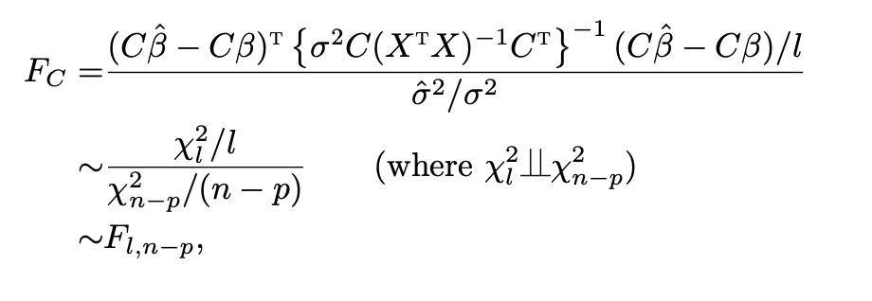

Inference: vector parameters
Replace $σ^{2}$ with its unbiased estimator ${\hat{σ}}^{2}$
Notes:
Question: is C(X^tX)^{-1}C^T positive definite?
Confidence region for Cbeta

Slide 12
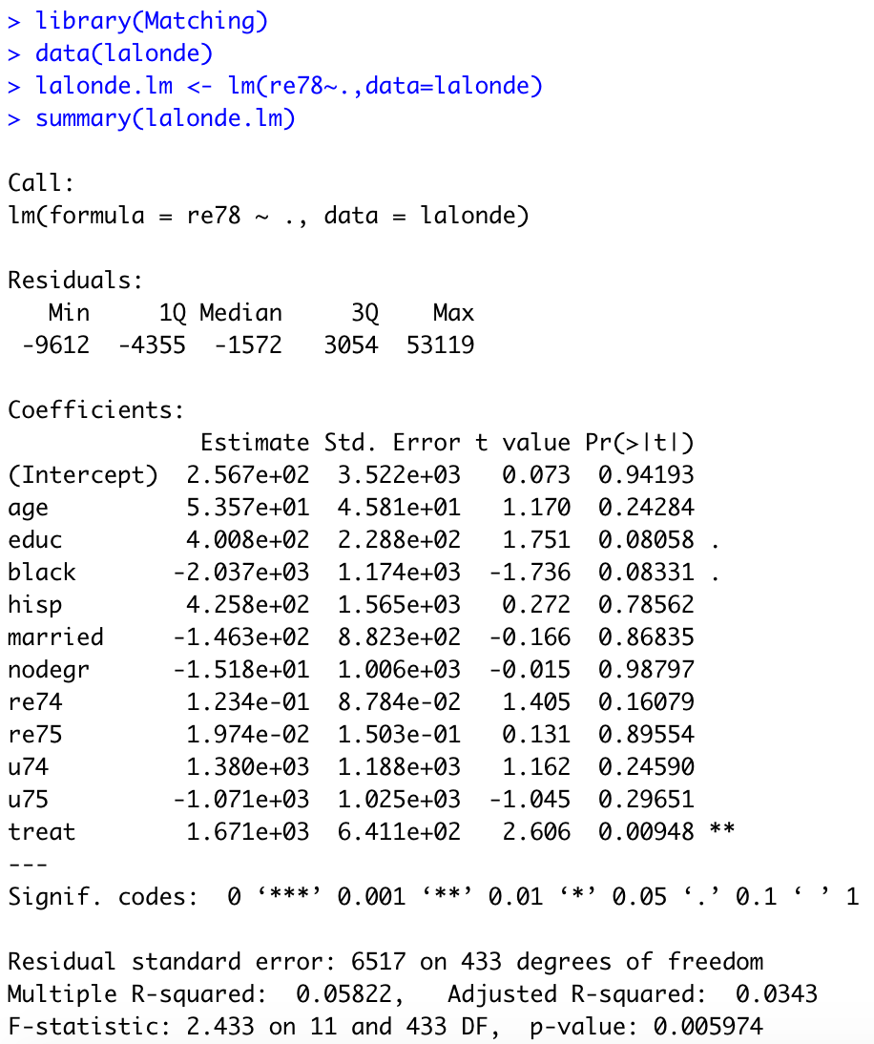
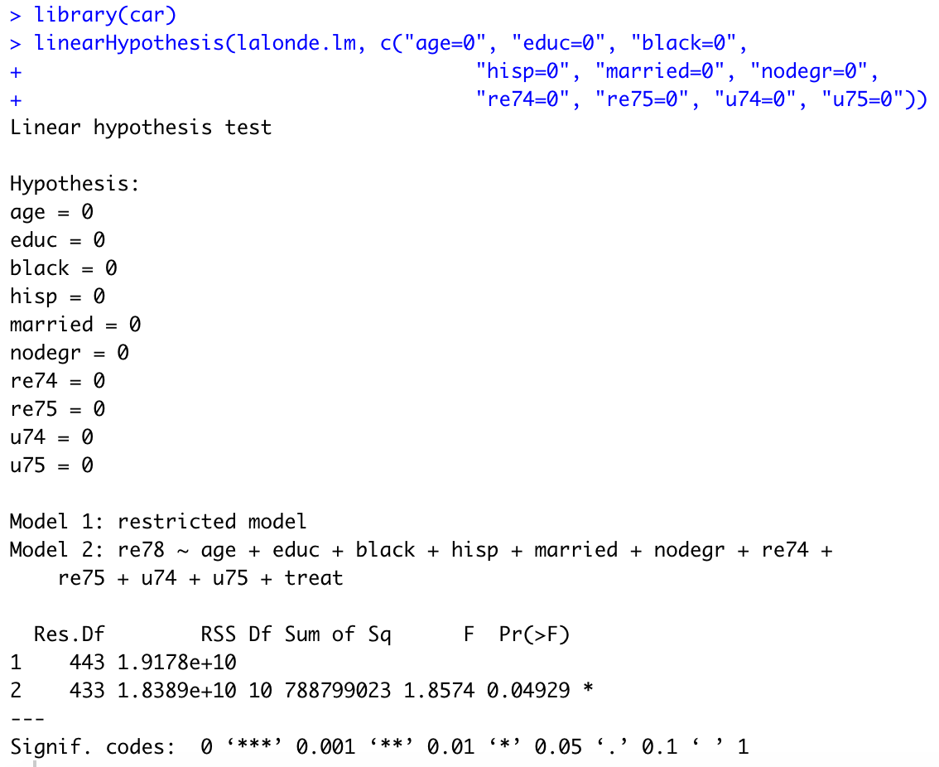
Real data analysis and R implementation

Slide 13

Revisit the one-way ANOVA
$X_{1j},…,X_{n_{j}j}$ for $j=1,…,b$ are i.i.d. with mean $μ_{j}$ and variance $σ^{2}$
Normal linear model: $X_{ij}=μ_{j}+ε_{ij},ε_{ij}∼N(0,σ^{2})$
OLS estimate: ${\hat{μ}}_{j}={\overline{X}}_{⋅j}, { \hat{σ}}^{2}=SSW/(n−b)$
One-way ANOVA: $H_{0}:μ_{1}=⋯=μ_{b}$
Rewrite the null hypothesis: $C{\left(μ_{1},…,μ_{b}\right)}^{T}=0$
F test

Slide 14
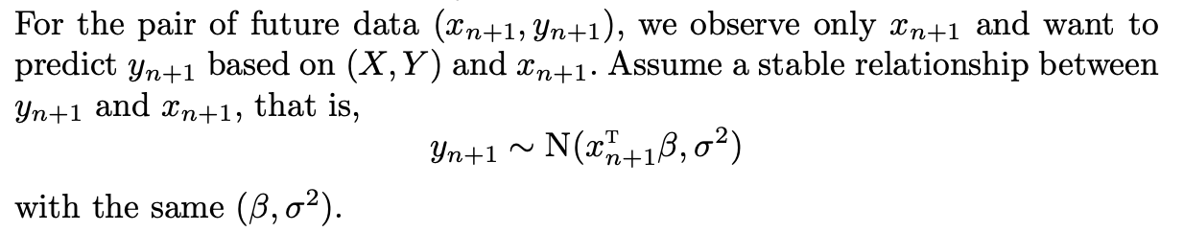


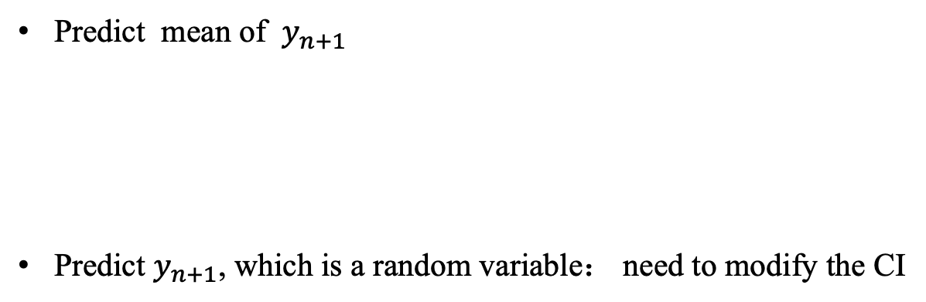
Prediction based on pivotal quantities
Predict mean of $y_{n+1}$
Predict $y_{n+1}$, which is a random variable： need to modify the CI
Unbiased predictor
CI
Notes:
Stable relationship is important for prediction
Prediction interval, pivotal quantity depend on y_n+1 and data, with its distribution not dependent on the data and parameter

Slide 15

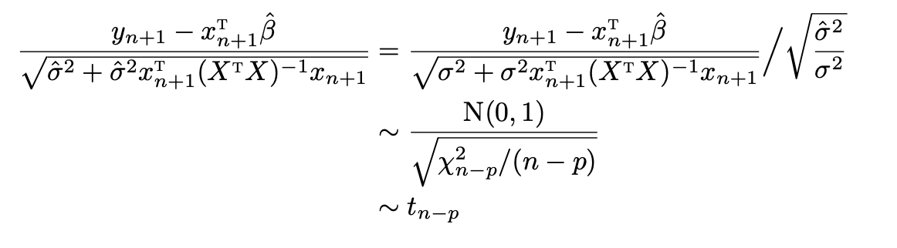

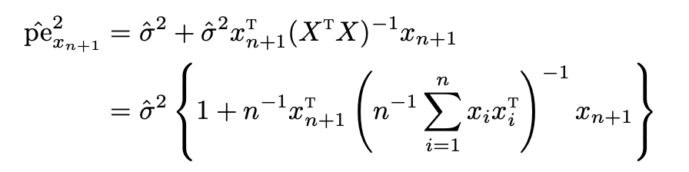

Prediction based on pivotal quantities
$1−α$ level prediction interval：
Notes:
Question: Which term dominates the prediction interval

Slide 16
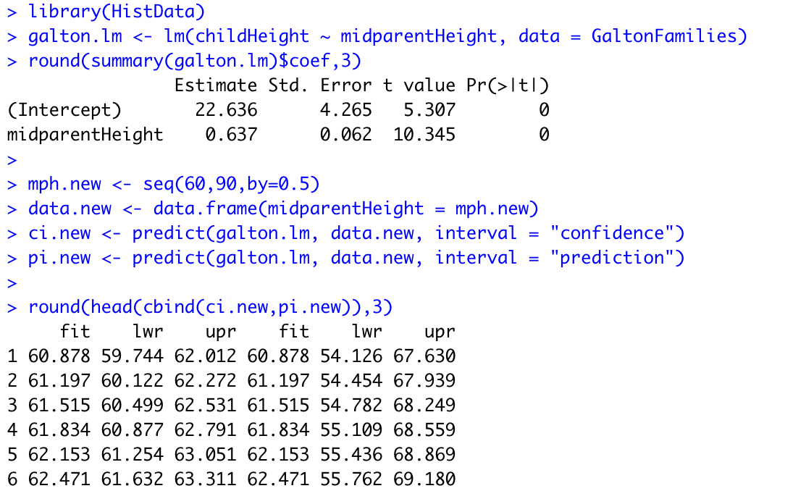
Real data analysis and R implementation
Notes:
Meaning of each number in summary of lm

Slide 17
Anscombe’s Quartet
Four data sets with one covariate
similar sample moments
OLS estimates are almost the same
Scatterplots are very different
Graphical diagnostics play a critical role in model assessment

Slide 18
Interpreting coefficients in linear model
It is important to correctly explain the results of OLS in plain language
Linear model is commonly used in social sciences
It is easy to get wrong
Interpretations depend on how we model the outcome and the covariates

Slide 19
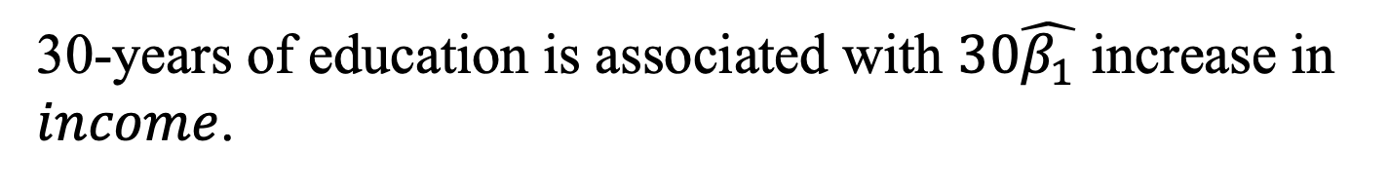
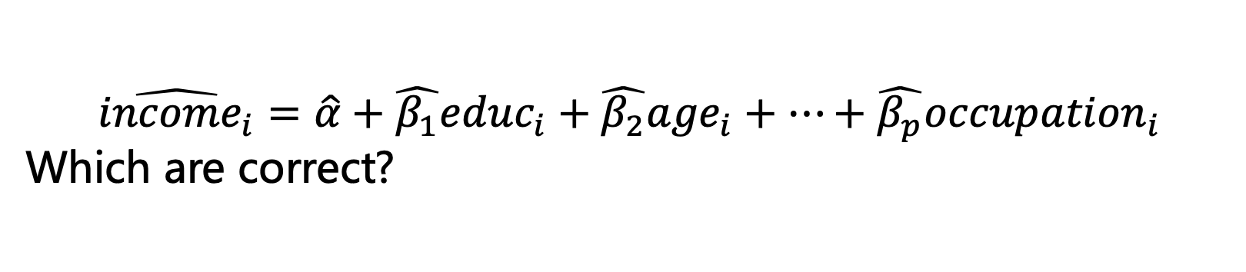
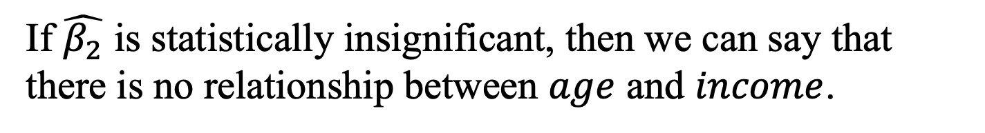
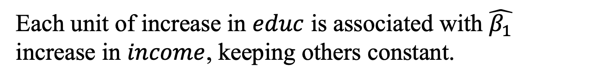
多选题
1分
$$\hat{{income}_{i}}=\hat{α}+\hat{β_{1}}{educ}_{i}+\hat{β_{2}}{age}_{i}+…+\hat{β_{p}}{occupation}_{i}$$
Which are correct?
A
Each unit of increase in $educ$ is associated with $\hat{β_{1}}$ increase in $income$, keeping others constant.
B
The effect of education on income is $\hat{β_{1}}$.
C
30-years of education is associated with $30\hat{β_{1}}$ increase in $income$.
D
If $\hat{β_{2}}$ is statistically insignificant, then we can say that there is no relationship between $age$ and $income$.
提交

Slide 20
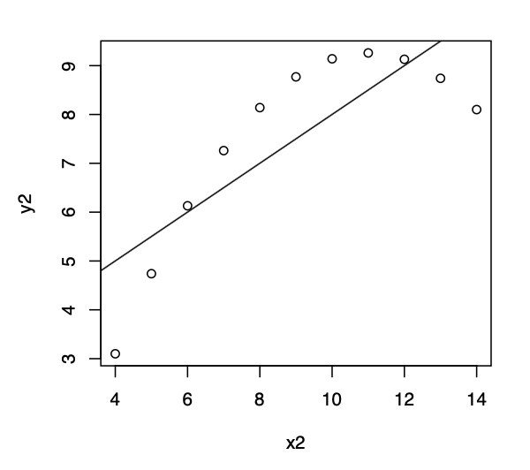

Quadratic terms
Sometimes, we include both $x_{i}$ and $x_{i}^{2}$ in the model
$$y_{i}=β_{0}+β_{1}x_{i}+β_{2}x_{i}^{2}+ε_{i}$$
Significance of $β_{2}$ indicates the relationship is nonlinear
Interpretation of $β_{1}$ changes because $x_{i}^{2}$ also changes when $x_{i}$ increases by one unit
It usually helps to see the relationship as a graph

Slide 21

Linear model with a categorical covariate
One covariate with $k$ levels
Compare three options
$k−1$ binary variables with the intercept, one for each category, the omitted category serves as the baseline group
$k$ binary variables without the intercept, one for each category
One variable as if the categorical variable is continuous

Slide 22

Interaction terms
Linear model without interaction term: $y_{i}=β_{0}+β_{1}x_{i1}+β_{2}x_{i2}+ε_{i}$
Relationship between $Y_{i}$ and $x_{i1}$ does not depend on the value of $x_{i2}$
Relationship between $Y_{i}$ and $x_{i2}$ does not depend on the value of $x_{i1}$
Linear model without interaction term: $y_{i}=β_{0}+β_{1}x_{i1}+β_{2}x_{i2}+β_{3}x_{i1}x_{i2}+ε_{i}$
Interaction term captures interactive effects between two covariates
One unit increase in $x_{i1}$ is associated with $β_{1}+β_{3}x_{i2}$ increase in the average value of $Y_{i}$, keeping $x_{i2}$ constant
Hierarchy principal: include $x_{i1}$ and $x_{i2}$ whenever $x_{i1}x_{i2}$ is in the model

Slide 23

Interaction terms
Question 1: How to add interaction terms for three variables? For example, $x_{1}$ is male or female, $x_{2}$ is Han or not Han, $x_{3}$ is urban/rural residence.
Question 2: How to test whether the relationship between gender and income differ by the type of industry (first/second/tertiary industry)? Compare the three options
Two regressions by subgroup, one for men and one for women.
One regression with gender and the interaction terms between gender and all other controls.
One regression with gender and the interaction terms between gender and income.

